Slide 1

Application Security –
Reducing the attack surface
CyberJutsuCon, 2021 | Roxy Tait

Slide 2

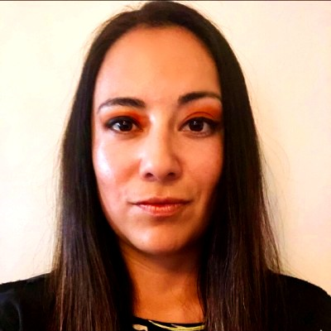

About Me
Roxy currently works in Information Security, specifically in Application Security.
She has experience working in the Financial (1 year) and Aerospace (12.5 years) industries and has consulted on several Healthcare Applications.
Her prior roles include Product Security, including embedded system design, Software Configuration Management and Penetration Testing.
Website designer and content creator for the blog, privacy4theworld.com
Education & Certifications: CEH, Security+, CySA+, CSAP, CM2C; BS Data Analytics, AS Behavioral Science.
https://www.linkedin.com/in/roxanne-sanger-tait/

Slide 3

“Good security starts with good design that considers the distributed nature of the application. Security is not a singular event, but rather a process that must be folded into the entire software development life cycle.”
― Andrew Hoffman, Web Application Security: Exploitation and Countermeasures for Modern Web Applications

Slide 4

Overview
One of the goals of an application security program is to aid in the overall reduction of risk to applications. Effectively managing security risks will result in good cyber hygiene. Shifting left in the SSDLC with an emphasis on application risk management will result in a strong and robust application security program.

Slide 5

So, you are a part of appsec - what now?
Application security programs vary greatly across companies and industries. The more involved the program is throughout the lifecycle of an application, the stronger it is.
Asserting the program as early as possible in the SSDLC will result in a more robust application.

Slide 6
Shifting Left to reduce risks

Slide 7

Planning
Review security aspects within a program plan.
  Is penetration testing required?
  Does an appsec person need to be involved?
  What is the schedule?
  Are proper resources allocated?
  Review of the Program or project plan will help prevent surprises or lack of resources later. It will also help ensure the proper security gates are followed and security decisions will not be made without your involvement.

Slide 8

Requirements
Security Requirements are defined and/or reviewed at this phase
  Some security or secure coding requirements should already exist and can take the workload off the security team.
OWASP’s ASVS and cheat sheets can be used as a guide to create application requirements.
https://owasp.org/www-project-application-security-verification-standard

Slide 9

Design
  Security reviews the application design documentation
  Architecture design review (may be a separate team).
  Threat Modeling begins

Slide 10
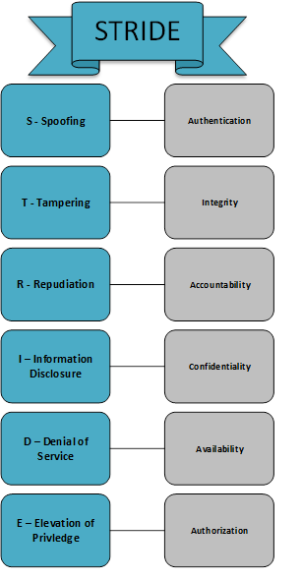
Threat Modeling
The goal of threat modeling is to get an overall understanding of the application being designed so that threat vectors can be uncovered.
The following items can be used as input into the process: Data Flows, Schemas, Diagrams, Requirements, Design Documentation or Baseline Standards.
QUESTIONS TO ASK
What are we working on? | What can go wrong?
What are we doing about it? | Did we do a good job?
Notes:
The goal of threat modeling is to get an overall understanding of the application being designed. When the team clearly understands the design, they can also understand the potential threat vectors. Mitigating these threats early can result in money saved later. When things are found postproduction, it costs a lot more time (think approvals and testing) to fix.
Data Flows, Schemas, Diagrams, Requirements, Design Documentation or Baseline Standards can be used as input into this exercise.
To be able to organize and frame the discussion a methodology is recommended. STRIDE is one of the most prevalent ones, it has been around since 1999 and stands the test of time. The chosen methodology should be tailored to fit into any product… It should be versatile.
Models: STRIDE, PASTA, LINDUNN, OCTAVE, etc. ((See back up slide for more))

Slide 11

Risk assessment
What do we do with the risks identified in the threat model?
Threat modeling is of no value if nothing is done with data.
It is highly recommended that a risk rating methodology be applied to the risks identified in the model.
Notes:
Threat modeling is of no value if nothing is done with data. An initial risk assessment can be completed after the threat model is done. You can create your own risk worksheet or use an existing methodology. For example, The IANS Pragmatic Threat Modeling Toolkit is a spreadsheet that helps organizations walk through the DREAD framework. DREAD uses a risk quantification scheme and is the mnemonic for Damage, Reproducibility, Exploitability, Affected Users, Discoverability.
Risks are rated on a scale of 1-10.

Slide 12
Risk assessment
Accept--
Transfer
Threats
Mitigate
Eliminate
Notes:
Every risk can be addressed in one of four ways. NIST 800-39 details in depth on the following concepts.
Mitigate—Risk mitigation planning is the process of developing options and actions to reduce threats. Most security controls revolve around mitigating risks.
Eliminate—Eliminating a risk entirely is hard to do, especially as threats evolve. This will typically result in a change in design.
Transfer—Moving the risk responsibility from one area to another, for example, moving a server from on prem to in the cloud, thus transferring some risk to the cloud provider.
Accept—If an organization is unable to mitigate, eliminate or transfer the risk, then it is accepting that risk. These may or may not be temporary risks that should be monitored.

Slide 13

Development
  The Development phase is where coding takes place.
  Secure Coding Techniques
  Static Application Security Testing (SAST)
  Software Composition Analysis (SCA)
  Peer Review

Slide 14

Test
Penetration testing occurs at this phase and can be done by either the organization itself or can be outsourced by a security company. There are pros and cons to both situations.
Testing can also be done via whitebox or blackbox testing methods. Whitebox is the preferred method.
Notes:
Penetration testing occurs at this phase and can be done by either the organization itself or can be outsourced by a security company. There are pros and cons to both situations. Testing can also be done via whitebox (pentester understand the design and has information) or blackbox (no information) method.Whitebox testing is the preferred method. When a penetration tester has all the design data, less effort is spent on trying to figure out how the application works. Remember – a real malicious hacker will have much more time on his/her hands.
In regard to whether or not you should perform an internal assessment or have the test outsourced, here are a couple of considerations:
Internal Testing
May be more cost effective, can be more frequently done.
May be considered less trustworthy from an outside perspective.
May not have the expertise in all domains.
Outsourcing
Reliable, consistent results and reporting
More trustworthy from an outside perspective

Slide 15

Release
Prior to production release or update, there should be a repository of all of the artifacts collected throughout the SSDLC phases. Review of these artifacts show compliance to the gates and adequately shows security was followed.
Once in production, continuous monitoring and penetration assessments should be completed, even if there has been no updates since the last release. Threats and risks continue to evolve, and the application should not be forgotten.

Slide 16

Ineffective AppSec Programs & Lessons Learned
“It’s an old code, Sir, but it checks out”
–Starwars Episode 4: A New Hope (1977)

Slide 17

#1 Involve AppSec
#2 SECURITY Requirements
Notes:
#1 – Failure to involve appsec: Where appsec involvement is limited or too late in the SSDLC ­can result in expensive fixes and breaches later. Some programs significantly limit the scope of their application security group to just a few responsibilities. If the entire SSDLC has coverage by a group, that is acceptable.
#2 Lack of requirements either existing or project specific can result in misconfigurations and vulnerabilities. Requirements need to be in a ‘shall’ format and not leave any wiggle room for people to misinterpret or go around the defined requirements. There should already be high level requirements that are common among all applications. It may be helpful to have a set of requirements that are prewritten before design/development begins. some examples are:
The application shall use HTTPS, The Open-Source components shall be the latest stable version, The principal of least privilege shall be in accordance with X, Y Z…

Slide 18

#3 Process awareness
#4 transparent Metrics and Reporting
Notes:
#3 ­It’s one thing to write a robust procedure, its another thing entirely to make sure that they are communicated and followed. Additionally, there should be security “gates” that ensure the processes are followed. For example, if you write a set of processes, are you sure that employees are following them? Someone (a person or a group) should review the application against the applicable set of processes.
#4 ­Metrics are a valuable tool that show areas that need improvement or show program status. There will always be a need to improve the program and at times, metrics may make your job stressful. Showcasing where the program needs improvement may put you in an uncomfortable position when presenting to upper-level management; ­Do not be intimidated! The metrics should be an honest representation of the program. If you are making improvements and showing that over time, you will be more respected for the honesty than using “fluff” or “feel good metrics.” “Fluff” or “feel good metrics” are metrics that are either are not a true representation of the program or useless metrics that look good to executive staff. People will eventually see through the “feel good” metrics.

Slide 19

#5 Application Inventories
#6 Tracking Bugs and Vulnerabilities
Notes:
#5 An application inventory is a database that has a list of all your applications. If this does not exist or is not frequently reviewed and updated – it is highly likely that you will miss something. Also, the need for this database and accuracy significant goes up with the size of the company.
#6 Tracking Vulnerabilities/bugs using an effective tool is imperative. It’s one thing to record them but entirely another to follow up and ensure they get remediated. An important metric that can be generated from this is ‘Mean time to remediation,’ or the typical amount of time that it takes to remediate a vulnerability, bug or risk.

Slide 20

#7 Too much or not enough automation?
Notes:
#7 Relying 100% on automation ­or having 0% will affect your organization. It may seem like 100% automation is the way to go but the reality is that human review, especially during the design phase is critical. The right balance varies per company, but it is common for the CI/CD pipeline to have unreviewed releases that actually have vulnerabilities that would have been caught if a human had reviewed the release. Alternatively, 0% automation will result in an extremely slow-release process that could also introduce vulnerabilities because a human did not thoroughly review a portion of the SSDLC where a tool or script would have caught easily.
If you are starting with 0-10% automation, work your way up slowly. The team should understand the process well and be able to do the tasks without a tool before one is added in. For example, if you are incorporating a SAST tool into the CI/CD pipeline, one should be comfortable with reviewing code and following the code review process. This will ensure that the company chooses right tool and that it will be implemented properly.
The maturity level of the organization will also need to be taken into consideration. In relation to CMM, ITIL, what is your maturity level? Knowing this will help understand the level of automation required and developing a roadmap in accordance with the goals.

Slide 21
Questions?
“The absence of security in the initial stages of Engineering is the single most significant cybersecurity gap and risk in modern system development.”
― Linda Rawson

